Slide 1
Cybersecurity
Network Intrusion Detection and Prevention

Slide 2

NIDS and NIPS
Network Intrusion Detection System
Alert and notify network operations, sound the alarm
Network Intrusion Prevention System
Stop the risk from entering network
Intrusions
OS exploits
Application exploits
Buffer overflows
Cross-site scripting
Remote access tools

Slide 3

In-Band versus Out-of-Band
In-Band
NIDS/NIPS in the traffic flow
Packets must traverse IDS/IPS
Out-of-Band
NIDS/NIPS not in traffic flow
Copy of each packet is sent to IDS/IPS

Slide 4




Out-of-band Response
Out-of-band
IPS not in traffic flow, receives copy of packets
IPS sends TCP RST (reset) to hosts when malicious traffic is found
Done after-the-fact
UDP has no reset
Prevents timely response
IPS
Switch

Slide 5
Out-of-band Response
IPS is not in traffic flow, switch sends copy of packets
IPS sends TCP RST (reset) to hosts when malicious traffic is found
Done after-the-fact
UDP has no reset
Prevents timely response
IPS
Switch

Slide 6

Out-of-band Response
IPS is not in traffic flow, switch sends copy of packets
IPS sends TCP RST (reset) to hosts when malicious traffic is found
Done after-the-fact
UDP has no reset
Prevents timely response
IPS
Switch

Slide 7


In-band Response
In-band
IPS is in traffic flow
Malicious traffic identified
Packet not allowed on network
Killed at the IPS
IPS
Switch
Internet
Firewall

Slide 8
In-band Response
In-band
IPS is in traffic flow
Malicious traffic identified
Packet not allowed on network
Killed at the IPS
IPS
Switch
Internet
Firewall

Slide 9

IPS rules
Rules determine fate of unwanted traffic
block, allow, send alert
Time consuming to manually create/maintain rules
False positives
False negatives
Disruption of service to users
Requires constant vigilance to catch any new/emerging threats

Slide 10
Identification technologies
Rule-based
Manually created set of rules
Requires constant tweaking and updating
Easily outdated
May require thousands of rules

Slide 11

Identification technologies
Signature-based
Uses pre-defined databases of known attacks (signatures)
Evaluates possible attacks based on matches
Requires signature database to be updated
Only as good as last update!

Slide 12
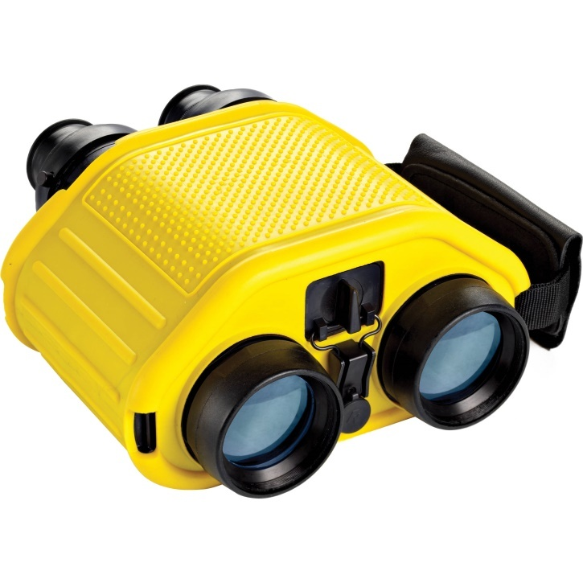
Identification technologies
Behavior-/Anomaly-based
Does not start with signature database
Establishes what “normal” looks like
Any activity out of the norm is suspect and reported/learned
Become more effective over time
Quickly, easily adapt to changes
Constantly learning, evolving

Slide 13

Identification technologies
Heuristic-based
Similar to behavior / anomaly
Starts with predefined signatures
Dynamically alters signatures based on learning what “normal” looks like
Constantly learning, evolving

Slide 14
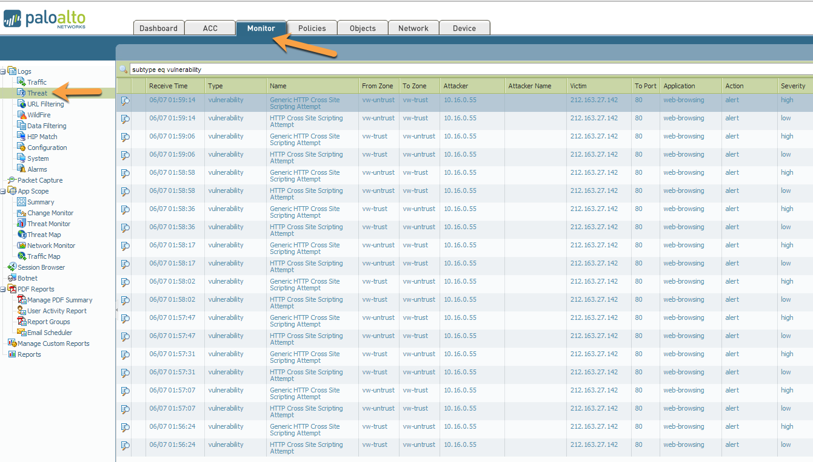
Example of IPS Rules

Slide 15
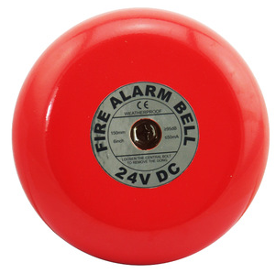
False positives
A report that isn’t true
False alarm
Mistaken identity
Too often, leads to desensitization
“Crying wolf”
Ignoring alerts

Slide 16
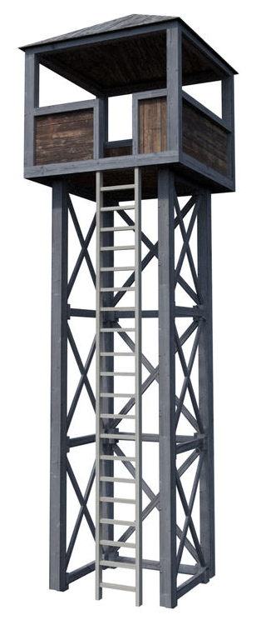
False negatives
Missed identifying something that should’ve been caught
Malicious traffic got through
Difficult to detect false negatives
It’s silent. There’s no alert something went wrong!
Industry can provide catch/miss rate tests

